Slide 1
Should Electrical Cars Replace Fuel-based Cars?

Slide 2
Overview of Team Pitch
Introduction to Team Issue
Significance of Team Issue
Summary of Differing Claims for the Team Issue
Team Claim
Team Arguments (Reasons & Evidence)
Team Pitch Conclusion

Slide 3
Introduction to Team Issue
1

Slide 4
It is expected that electric cars may rule the world’s roads by 2040 how will it impact us?

Slide 5
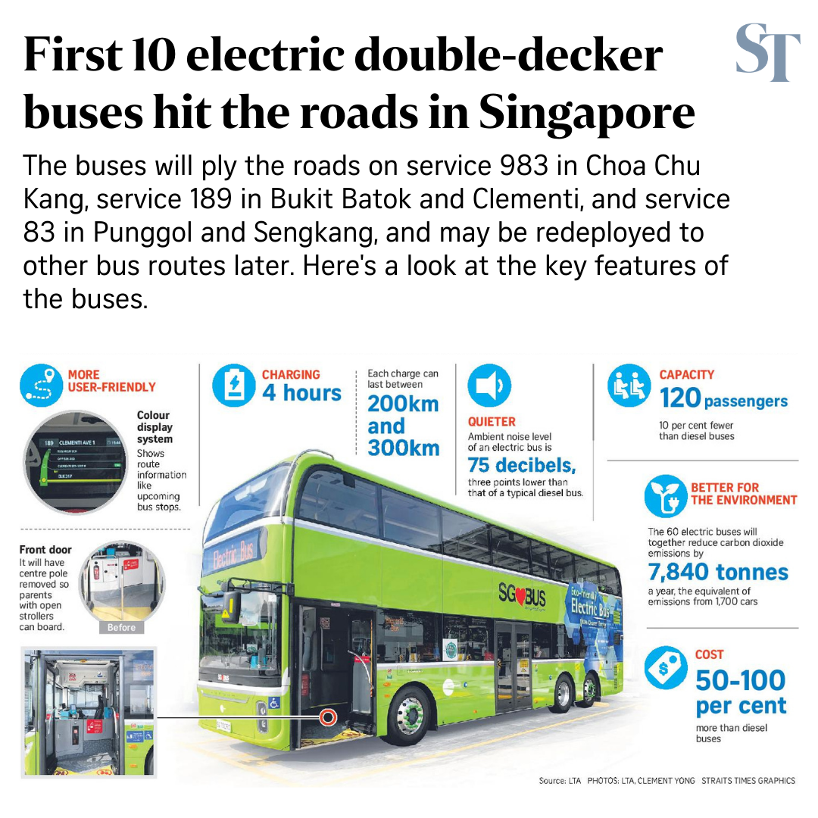
(YONG, 2020)

Slide 6
Significance of Team Issue
2

Slide 7
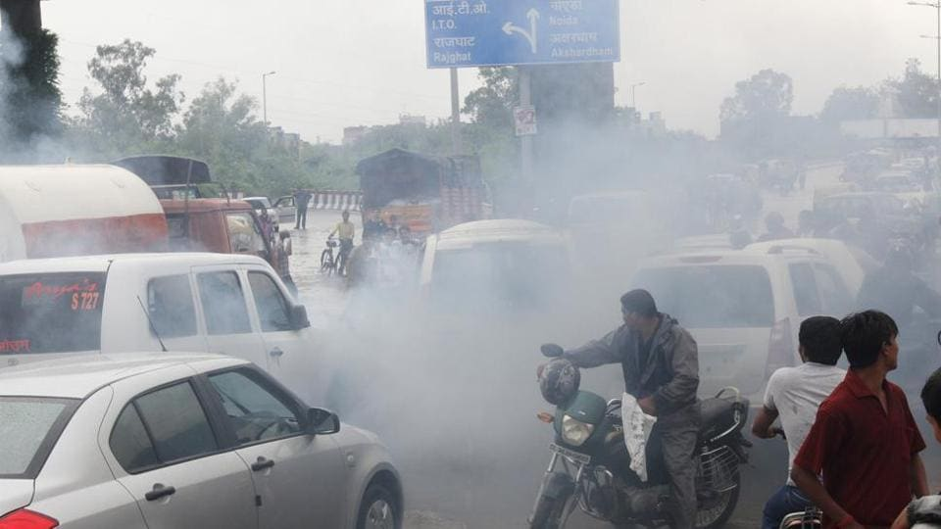
Air pollution from fuel-based cars (BUREAU, 2017)

Slide 8
Significance of Team Issue
4.6 metric tons of carbon dioxide is emitted every year
(Help Make Transportation Greener | US EPA, n.d.)
Fuel for fuel-based cars is very expensive in Singapore ,$2.42 per Liter (Singapore gasoline prices, 26-Jul-2021 | GlobalPetrolPrices.com, n.d.)

Slide 9
Summary of Differing Claims for the Team Issue
3

Slide 10
Arguments “FOR” the Team Issue
Electric cars produces less carbon emissions in their lifetime compared to petrol and hybrid cars. (Harvey, 2021)
Cost of Electric vehicles are cheaper than fossil fuel-based cars. (Partridge, 2021)

Slide 11
Arguments “AGAINST” the Team Issue
Electric car's lithium battery produces a lot of carbon emissions and a lot of rare minerals. (Rowlatt, 2021)
Electric cars are hard to charge and do not travel long distances(Joanna, 2021)

Slide 12
Team Claim
4

Slide 13
Team Claim
Electric vehicles should replace fuel-based vehicles

Slide 14
Team Arguments Reasons & Evidence
5

Slide 15
Reason 1
Electric Vehicles produce fewer toxic gases compared to a fuel-based vehicle, which will help the environment and lower carbon emissions.

Slide 16
Evidence 1
Less pollution:
By choosing to drive an EV you are helping to reduce harmful air pollution from exhaust emissions. An EV has zero exhaust emissions. (Benefits Of Electric Cars, 2021)

Slide 17
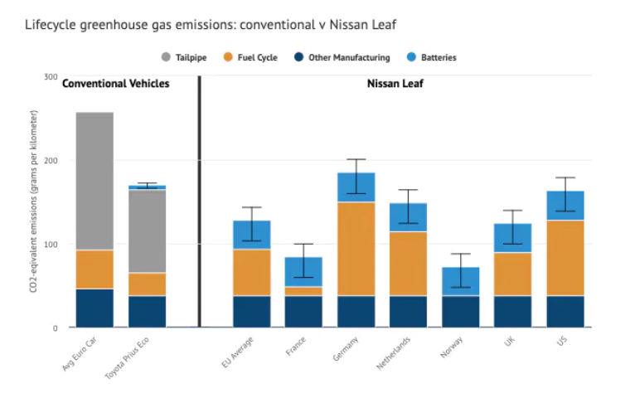
Evidence 2
EVs are responsible for considerably lower emissions over their lifetime than conventional (internal combustion engine) vehicles across Europe as a whole. (Hausfather, 2021)

Slide 18
Reason 2
Electric vehicles will increase the demand of lithium which will promote research and development for lithium batteries like higher energy efficiency and better recycling yield

Slide 19
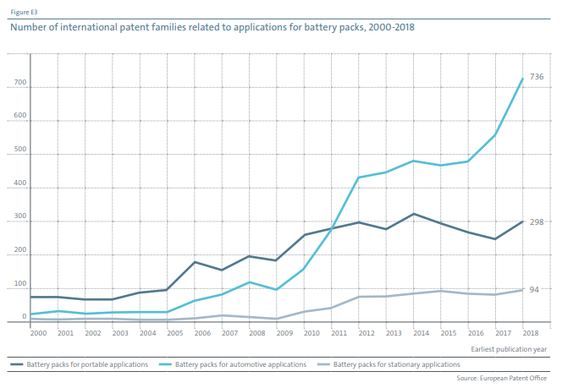
Evidence 1
(Innovation in batteries and electricity storage, 2021)

Slide 20
Evidence 2
Recycling methods for recovering and reusing battery materials without costly processing. One approach calls for removing the electrolyte with supercritical carbon dioxide, then crushing the cell and separating the components physically (Jacoby, 2021)

Slide 21
Reason 3
The upkeep of electrical cars is cheaper than fuel-based vehicles

Slide 22
Evidence 1
This is because, electrical vehicles has fewer moving parts as compared to fuel-based vehicles ,which reduces less wear-and tear (Harto, 2020)
Owners do not need to send their vehicles for maintenance as often
Owners spend less money on maintenance cost hence the upkeep of electrical cars is cheaper

Slide 23
Evidence 2
A study done by Energy Supply Association of Australia (ESAA) shown it is 58% cheaper to recharge electrical car then pump fuel for fuel-based vehicles,(Guterres, 2014)
Electrical vehicles are spending less then fuel-based vehicles when re-fuelling their vehicles​
Due to the cost of recharging electrical cars being cheaper than
refueling fuel based vehicles, the upkeep of electrical cars is cheaper

Slide 24
Team Pitch Conclusion
6

Slide 25
Team Pitch Conclusion
To Conclude, Electric vehicles should replace fuel-based vehicles
Electric cars are less harmful to the environment
The upkeep cost less
Promote innovation of better technology for lithium batteries

Slide 26
END

Slide 27
References
(in Harvard Citation Style)

Slide 28
References
BUREAU, D., 2017. Supreme Court rules smoke certificate mandatory for auto insurance. [online] Kairali News | Kairali News Live l Latest Malayalam News. Available at: <https://www.kairalinewsonline.com/2017/08/11/124745.html> [Accessed 4 August 2021].
Ergon Energy. 2021. Benefits Of Electric Cars. [online] Available at: <https://www.ergon.com.au/network/smarter-energy/electric-vehicles/benefits-of-electric-vehicles> [Accessed 3 August 2021].
Harto, C., 2020. Electric Vehicle Ownership Costs: Chapter 2—Maintenance. [ebook] Consumer Report, pp.3 , 4. Available at: <https://advocacy.consumerreports.org/wp-content/uploads/2020/09/Maintenance-Cost-White-Paper-9.24.20-1.pdf> [Accessed 3 August 2021].

Slide 29
References
(Harvey, 2021) (Harvey, F., 2021. Electric cars produce less CO2 than petrol vehicles, study confirms. [online] the Guardian. Available at: <https://www.theguardian.com/environment/2020/mar/23/electric-cars-produce-less-co2-than-petrol-vehicles-study-confirms> [Accessed 3 August 2021].)
Hausfather, Z., 2021. Factcheck: How electric vehicles help to tackle climate change. [online] Eco-Business. Available at: <https://www.eco-business.com/news/factcheck-how-electric-vehicles-help-to-tackle-climate-change/> [Accessed 3 August 2021].
Guterres, J., 2014. Vehicle fuel cost per litre - Electricity vs. Petrol. [online] Reduction Revolution. Available at: <https://reductionrevolution.com.au/blogs/news-reviews/11530353-vehicle-fuel-cost-per-litre-electricity-vs-petrol> [Accessed 3 August 2021].
GlobalPetrolPrices.com. 2021. Singapore gasoline prices, 26-Jul-2021 | GlobalPetrolPrices.com. [online] Available at: <https://www.globalpetrolprices.com/Singapore/gasoline_prices/> [Accessed 2 August 2021].
Jacoby, M., 2021. It’s time to get serious about recycling lithium-ion batteries. [online] Cen.acs.org. Available at: <https://cen.acs.org/materials/energy-storage/time-serious-recycling-lithium/97/i28> [Accessed 3 August 2021].

Slide 30
References
www.epo.org. 2021. Innovation in batteries and electricity storage. [ebook] Giuliano Gregori, Stefano Meini, Yann Ménière, Javier Pose Rodríguez, Ilja Rudyk, Simon Bennett, Nick Johnstone, Luis Munuera, p.7. Available at: <https://www.actu-environnement.com/media/pdf/news-36144-etude-oeb-batteries-brevets.pdf> [Accessed 3 August 2021].​
US EPA. n.d. Help Make Transportation Greener | US EPA. [online] Available at: <https://www.epa.gov/greenvehicles/help-make-transportation-greener> [Accessed 3 August 2021].​
Partridge, J., 2021. Electric cars ‘will be cheaper to produce than fossil fuel vehicles by 2027’. [online] the Guardian. Available at: <https://www.theguardian.com/business/2021/may/09/electric-cars-will-be-cheaper-to-produce-than-fossil-fuel-vehicles-by-2027> [Accessed 3 August 2021].
Rowlatt, J., 2021. How electric cars are charged and how far they go: your questions answered. [online] BBC News. Available at: <https://www.bbc.com/news/science-environment-54989167> [Accessed 3 August 2021].
YONG, C., 2020. First 10 double-decker electric buses begin plying Singapore roads. [online] The Straits Times. Available at: <https://www.straitstimes.com/singapore/first-10-double-decker-electric-buses-begin-plying-singapore-roads> [Accessed 4 August 2021].

